Slide 1


FINAL YEAR PROJECTS
Academic Session: 2023-24

Slide 2
FINAL YEAR PROJECTS Methodology

Slide 3

Approach
Methodology

Slide 4


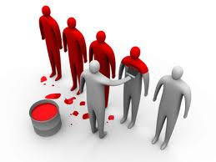
Approach

Slide 5
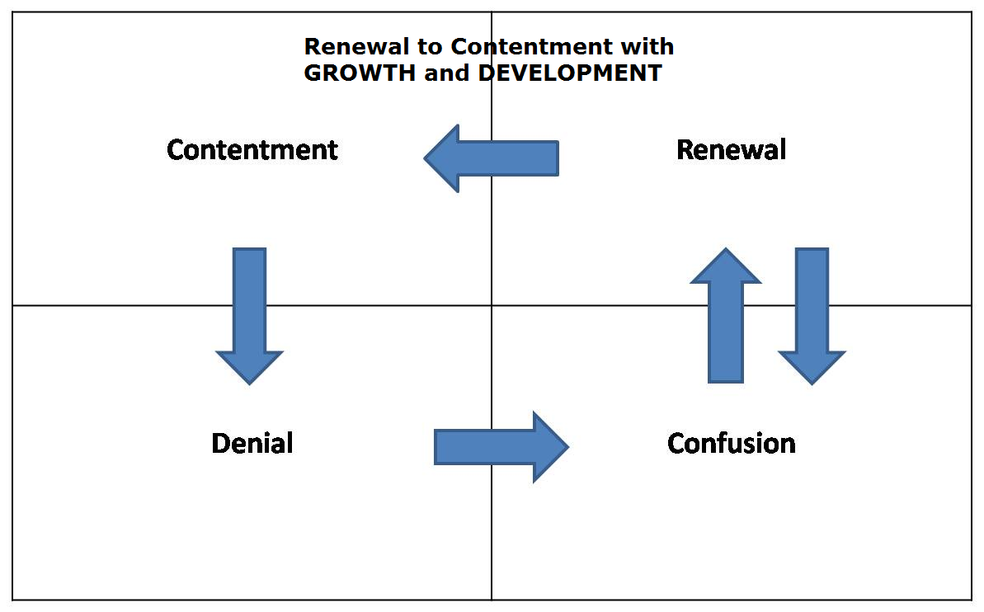
Approach

Slide 6
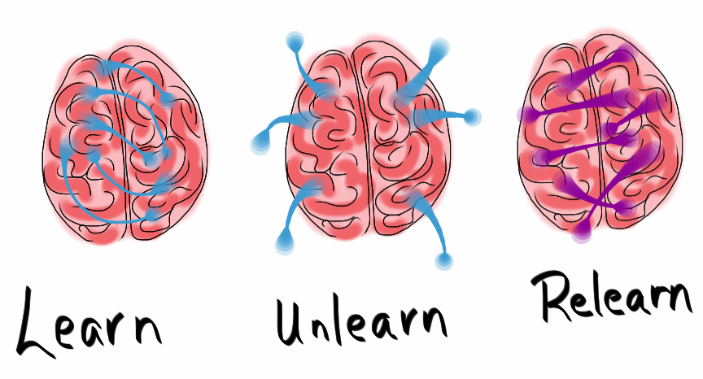
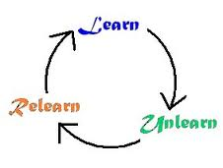
Approach

Slide 7
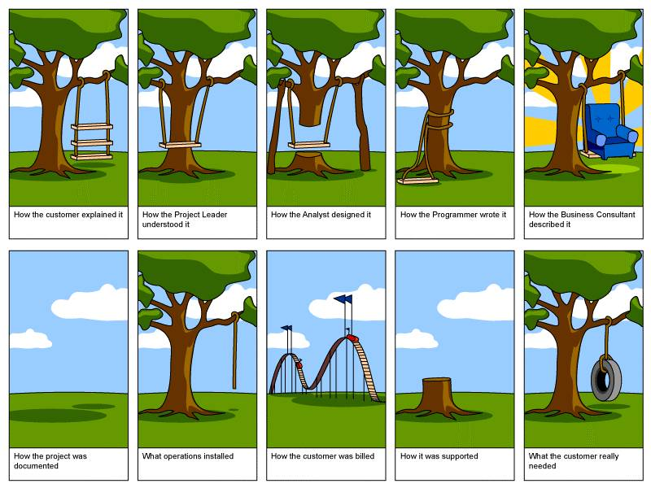
EXPECTATIONS
Exercise

Slide 8
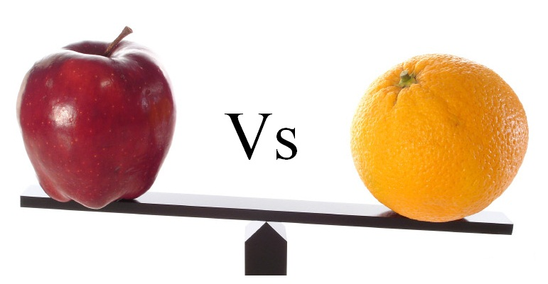

Slide 9
WATERFALL MODEL
AGILE

Slide 10
Approach
Agile Meaning – Quick and well-coordinated in movement
Based on iterative and incremental development
Aims to allow a high level flexibility
Requires close collaboration with the customer or stakeholder.

Slide 11
AGILE
Individuals and interactions over processes and tools
Working software over comprehensive documentation
Customer collaboration over contract negotiation
Responding to change over following a plan

Slide 12
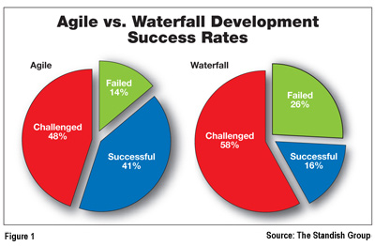
AGILE

Slide 13
AGILE
SCRUM
Agile Methods
Scrum
Extreme Programming (XP)
Adaptive Software Development (ASD)
Dynamic Systems Development Method (DSDM)

Slide 14
What is Scrum?

Slide 15
What is Scrum?
Scrum is a management framework for incremental product development using one or more cross-functional, self-organizing teams.

Slide 16
What is Scrum?
It provides a structure of roles, meetings, rules, and artifacts. Teams are responsible for creating and adapting their processes within this framework.

Slide 17
What is Scrum?
Scrum uses fixed-length iterations, called Sprints, which are typically 1-2 weeks long (never more than 30 days). Scrum teams attempt to build a potentially shippable (properly tested) product increment every iteration.

Slide 18
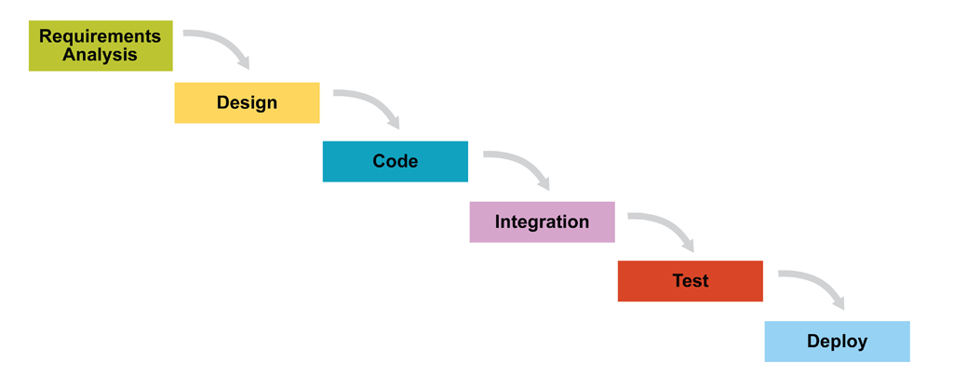
What is Scrum?
Jan | Feb | Mar | Apr | May | Jun | Jul | Aug | Sep | Oct | Nov | Dec

Slide 19
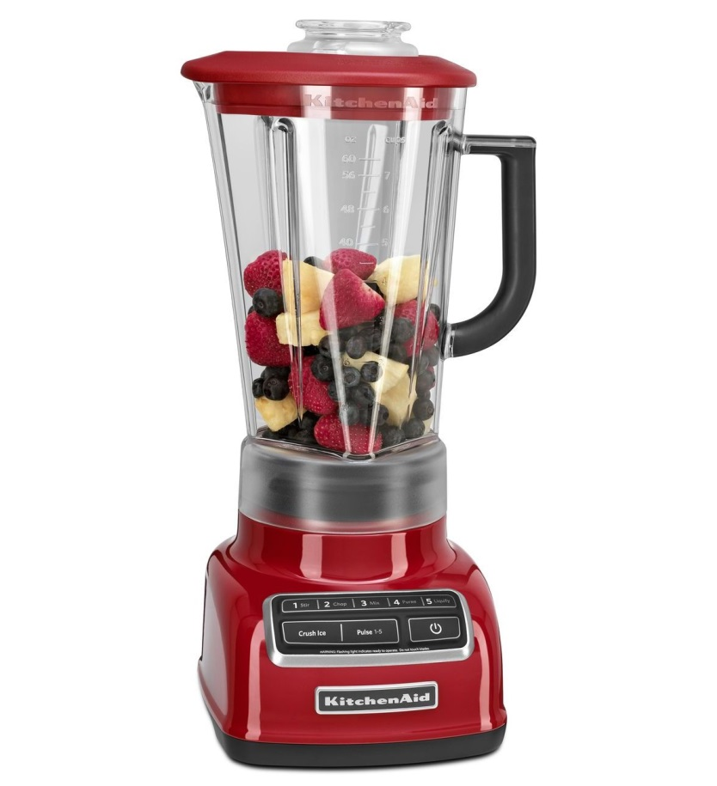

What is Scrum?

Slide 20
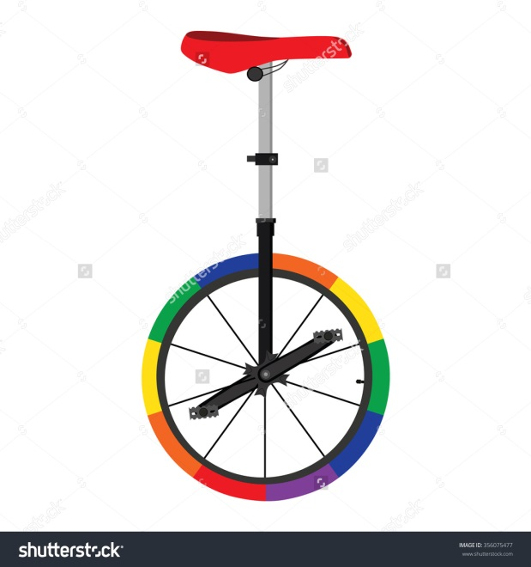
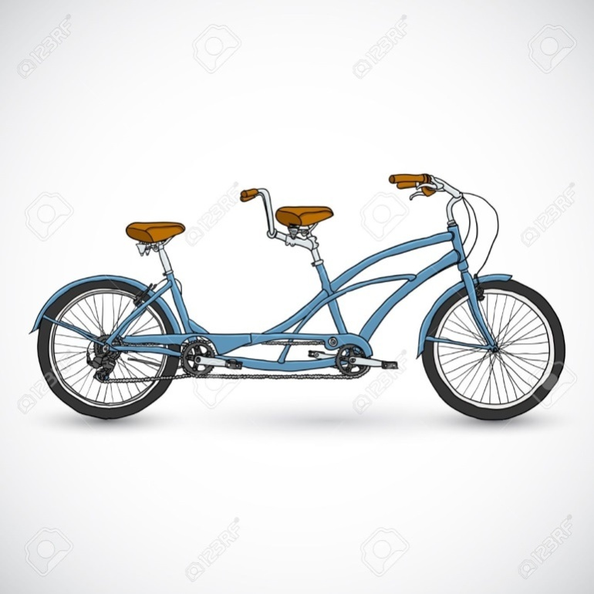
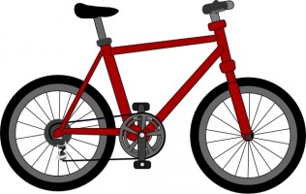
What is Scrum?

Slide 21
Warning…
Scrum is
HARD to practice
It takes
courage and commitments

Slide 22
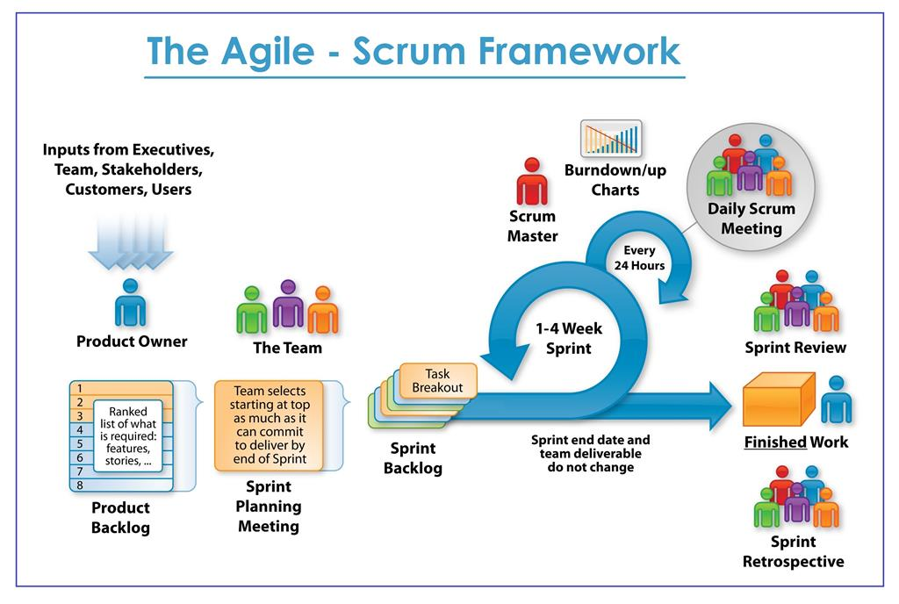

Slide 23
Scrum Roles

Slide 24
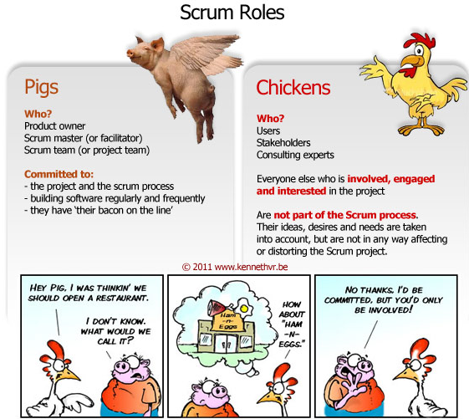

Slide 25
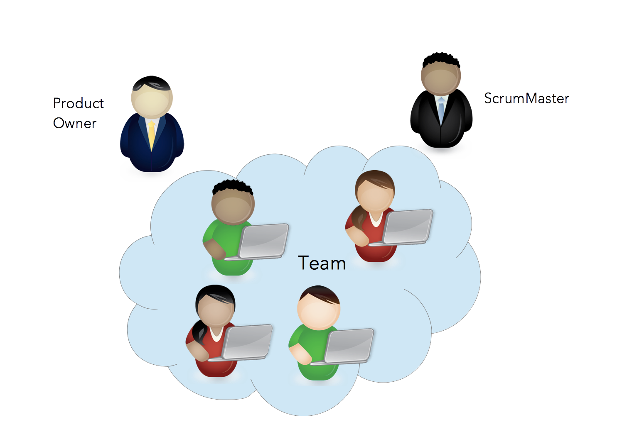
SCRUM (Roles)

Slide 26
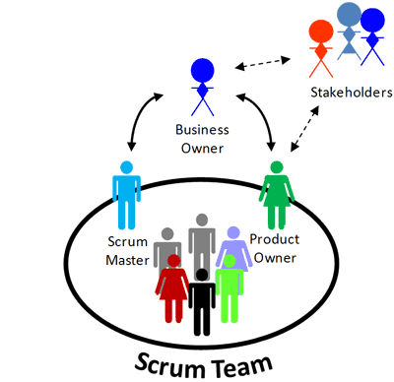

Slide 27
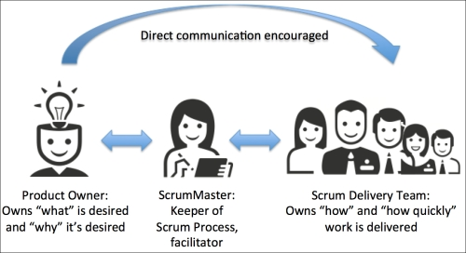

Slide 28
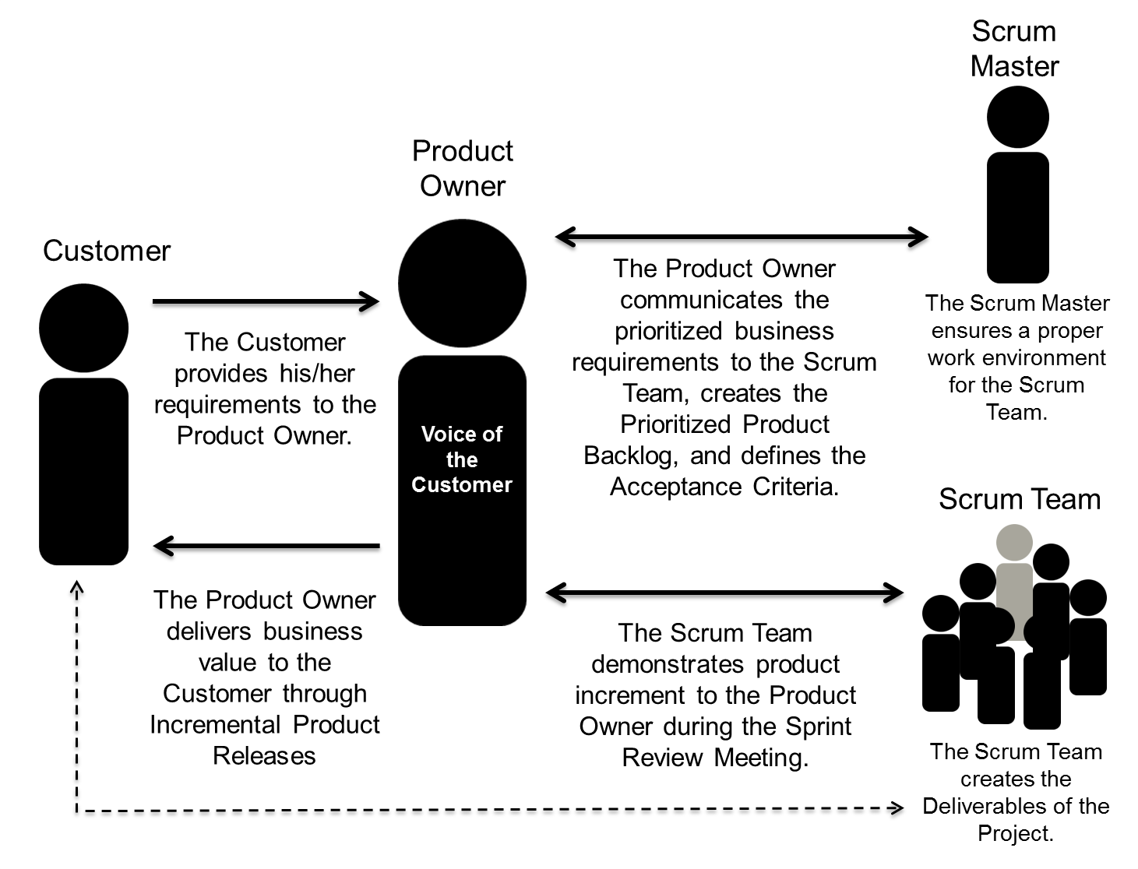

Slide 29
Scrum Meetings

Slide 30
SCRUM (Meetings)
Pre-Project /Kick-Off Meeting
Sprint Planning Meeting
Daily Scrum
Sprint Review Meeting
Weekly Meeting with Product Owners and Scrum Masters

Slide 31
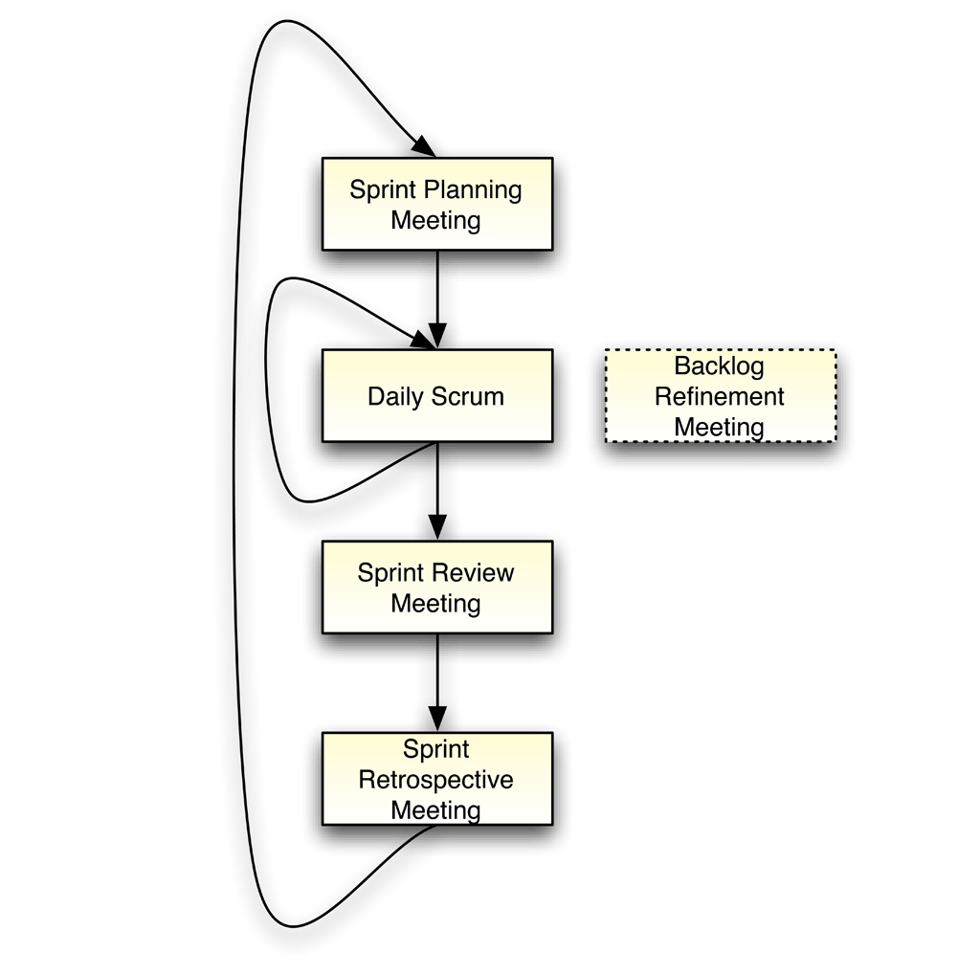
SCRUM (Meetings)

Slide 32
SCRUM (Meetings)
Pre-Project /Kick-Off Meeting
A special form of Project Planning Meeting
Meeting before the begin of the Project

Slide 33
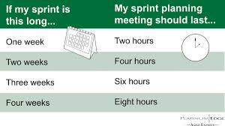
SCRUM (Meetings)
Sprint Planning Meeting
A collaborative meeting in the beginning of each Sprint among the Product Owner, the Scrum Master and the Team

Slide 34
SCRUM (Meetings)
Sprint Planning Meeting
1st Part:
Creating Product Backlog
Determining the Sprint Goal.
Participants: Product Owner, Scrum Master, Scrum Team
2nd Part:
Participants: Scrum Master, Scrum Team
Creating Sprint Backlog

Slide 35
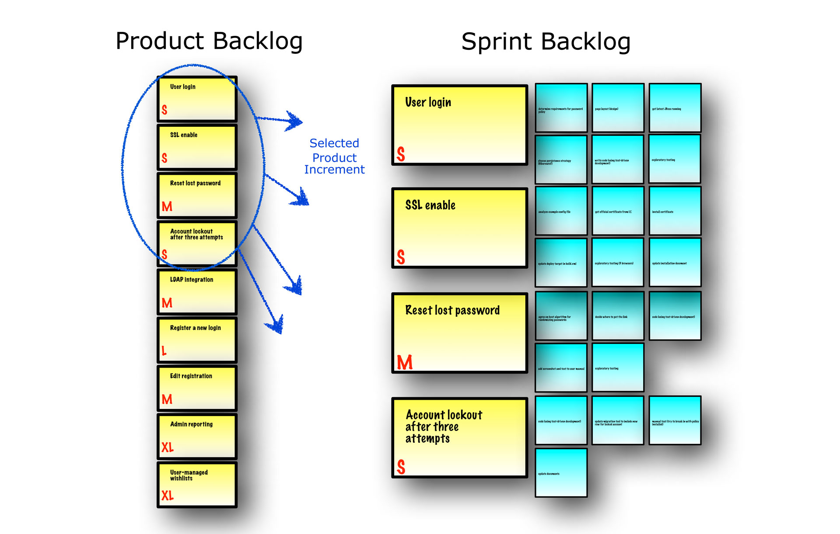

Slide 36

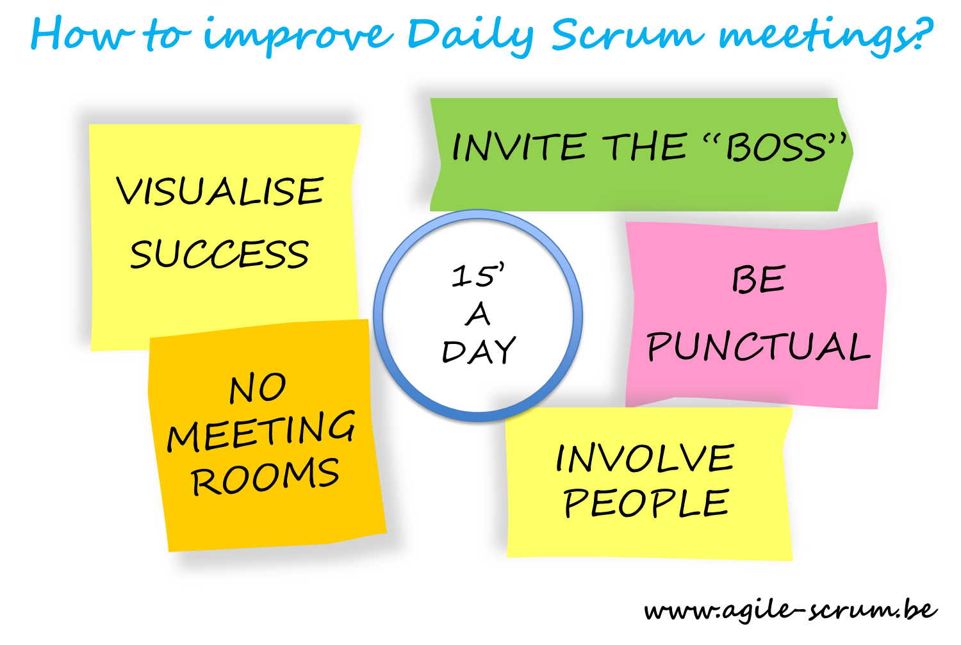
SCRUM (Meetings)

Slide 37
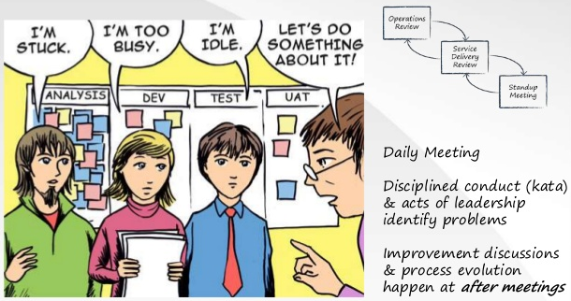
SCRUM (Meetings)

Slide 38
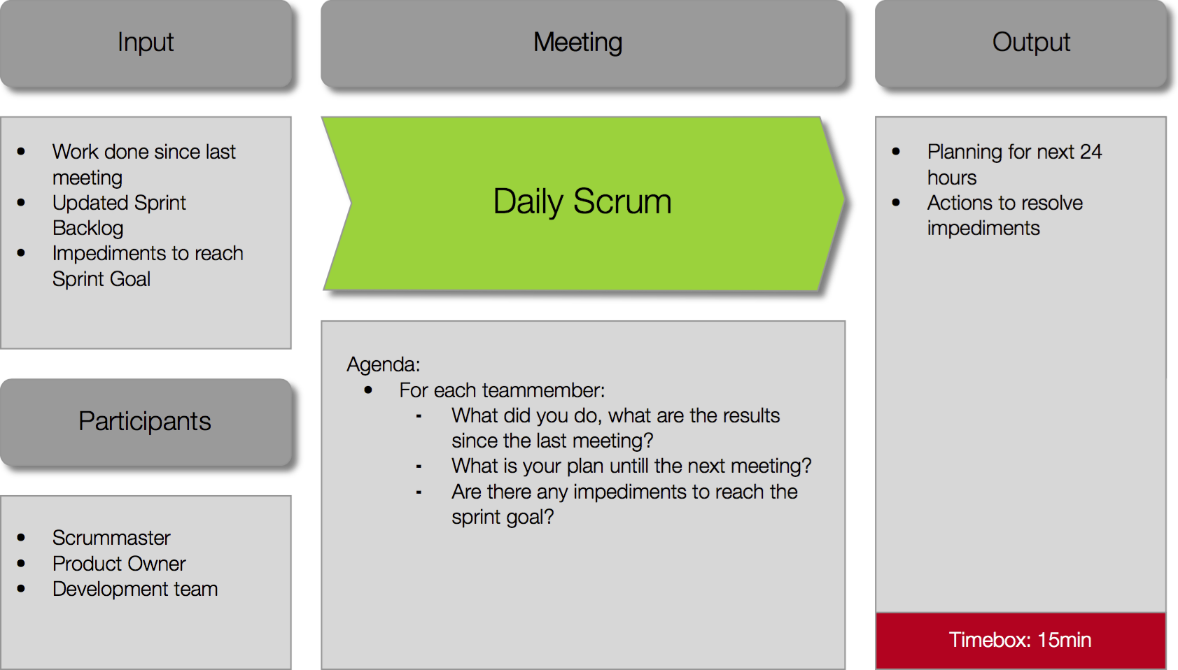

Slide 39
SCRUM (Meetings)
Sprint Review Meeting
Is held at the end of each Sprint
Business functionality which was created during the Sprint is demonstrated to the Product Owner
Informal, should not distract Team members of doing their work

Slide 40
Scrum Artifacts

Slide 41
SCRUM (Artifacts)
Product Backlog
Requirements for a system, expressed as a prioritized list of Backlog Items
Is managed and owned by a Product Owner
Spreadsheet (typically)

Slide 42
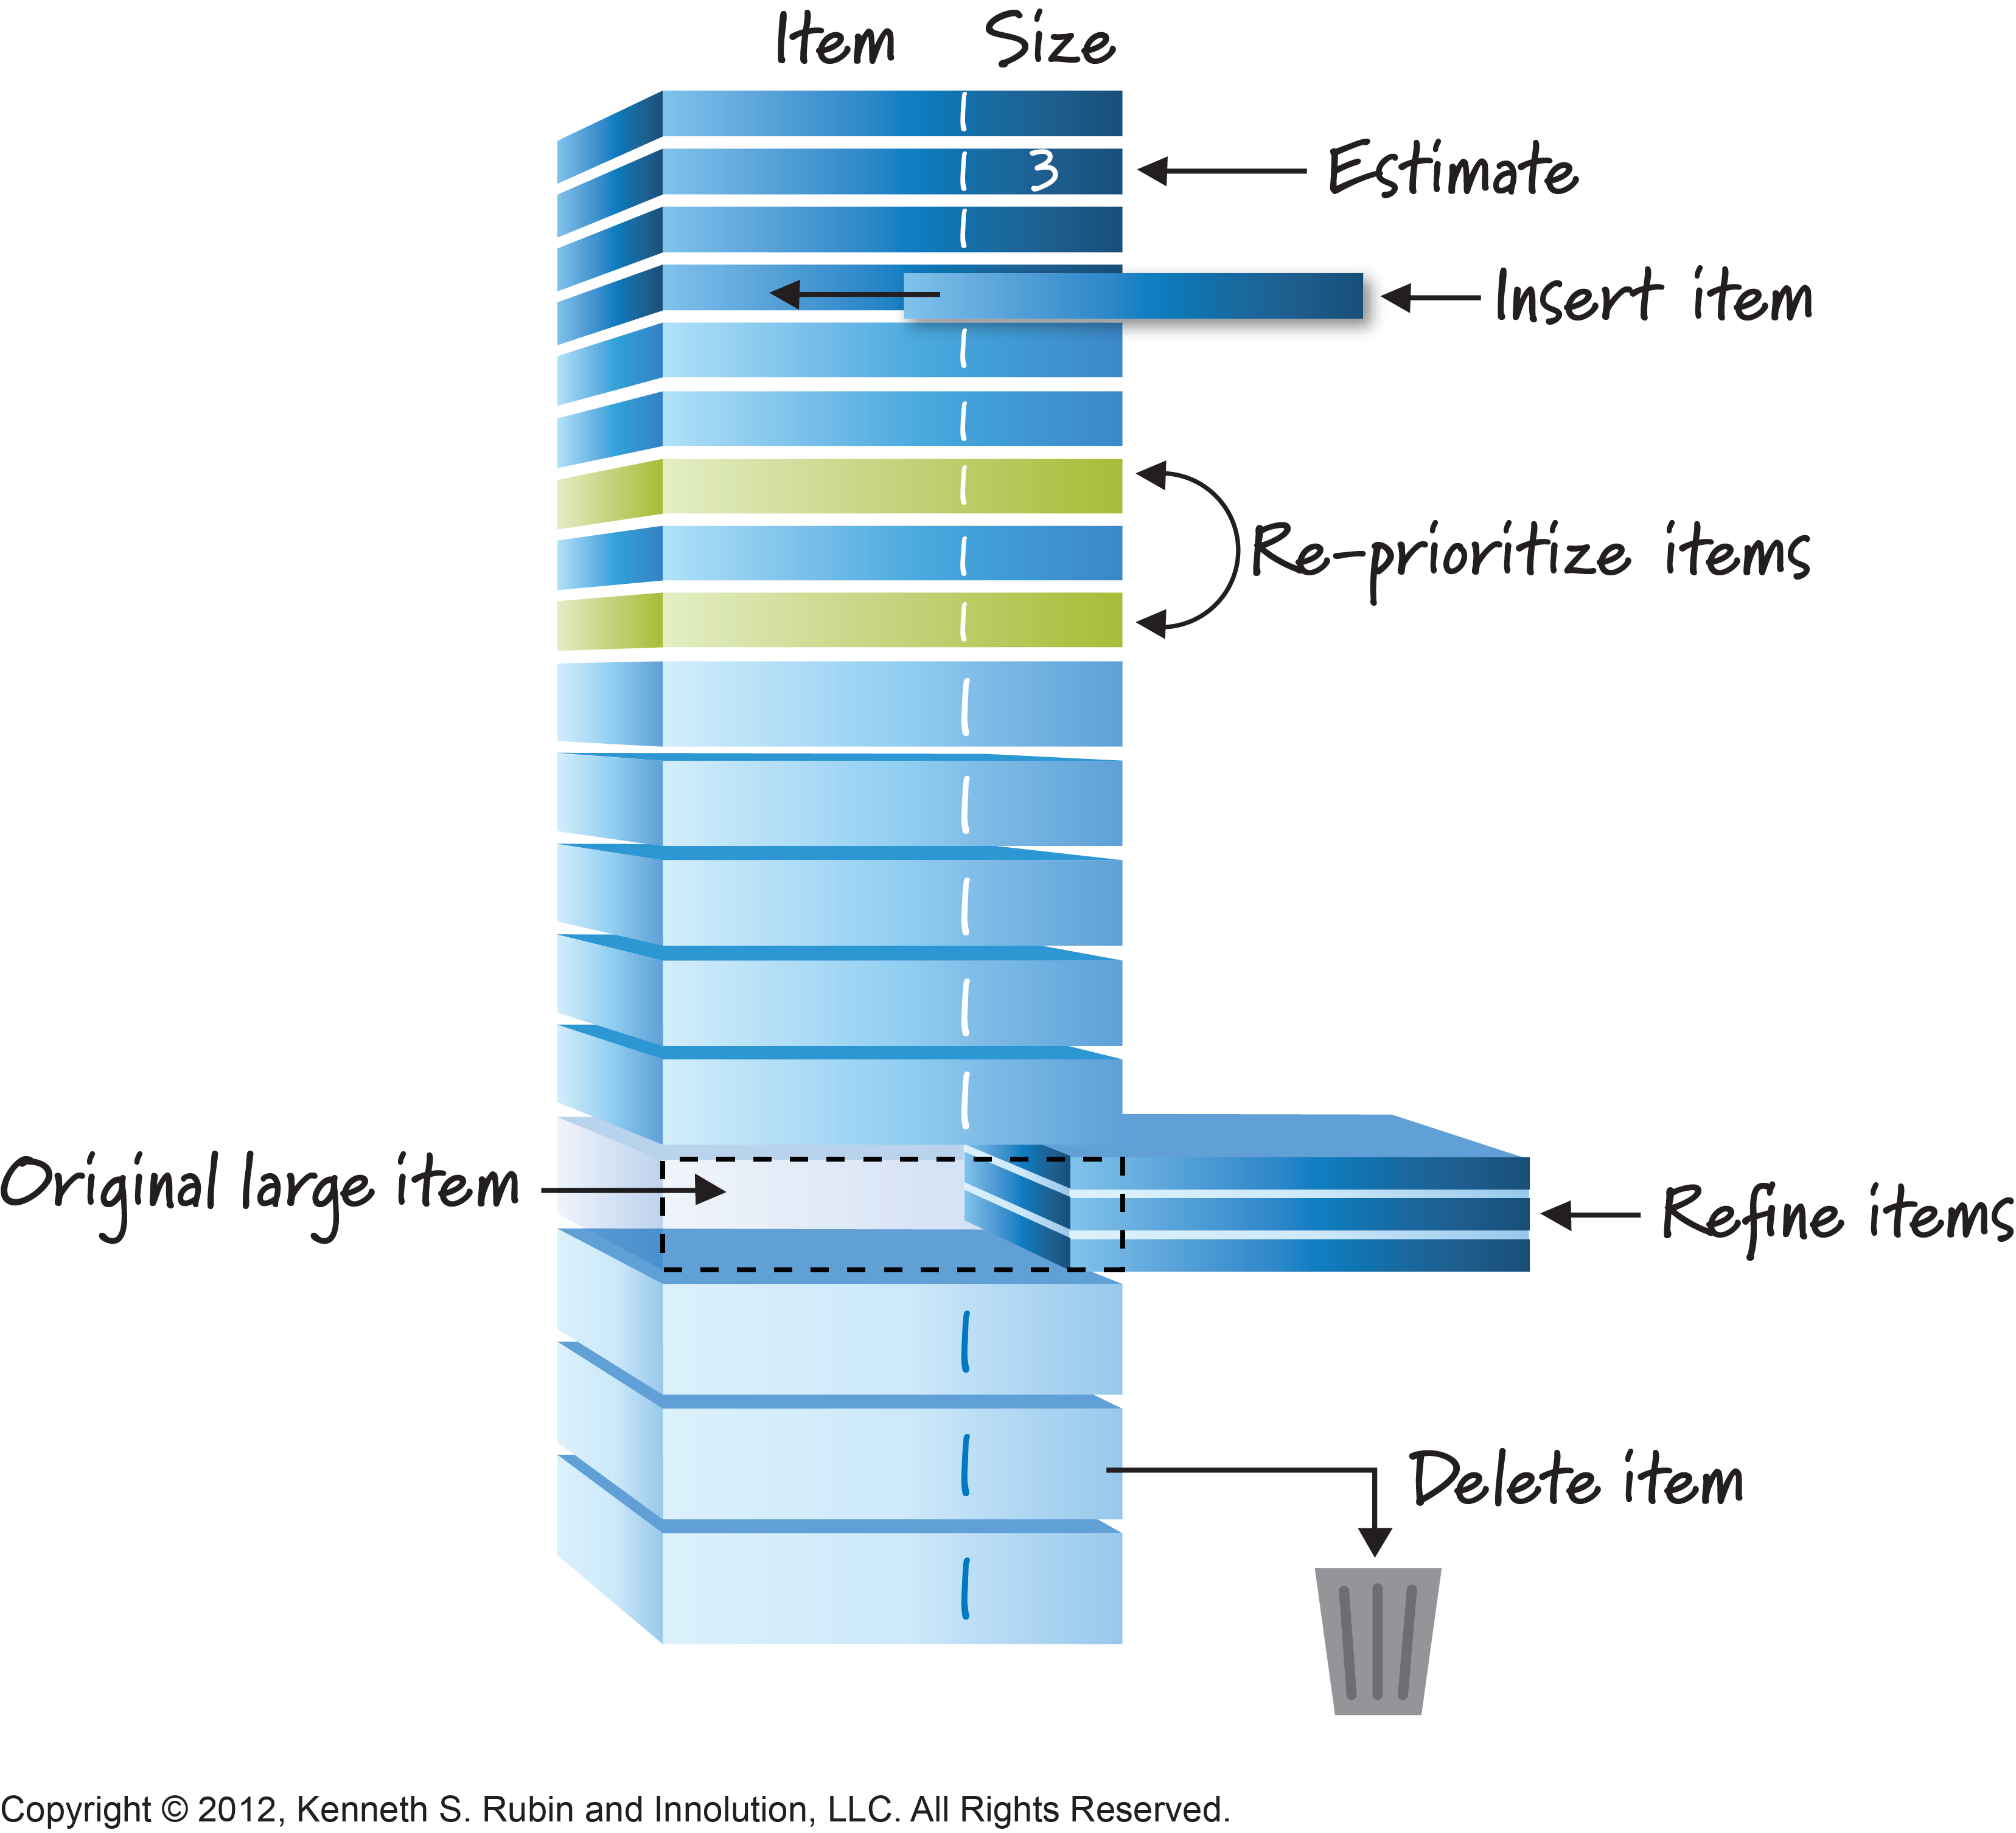
SCRUM (Artifacts)

Slide 43
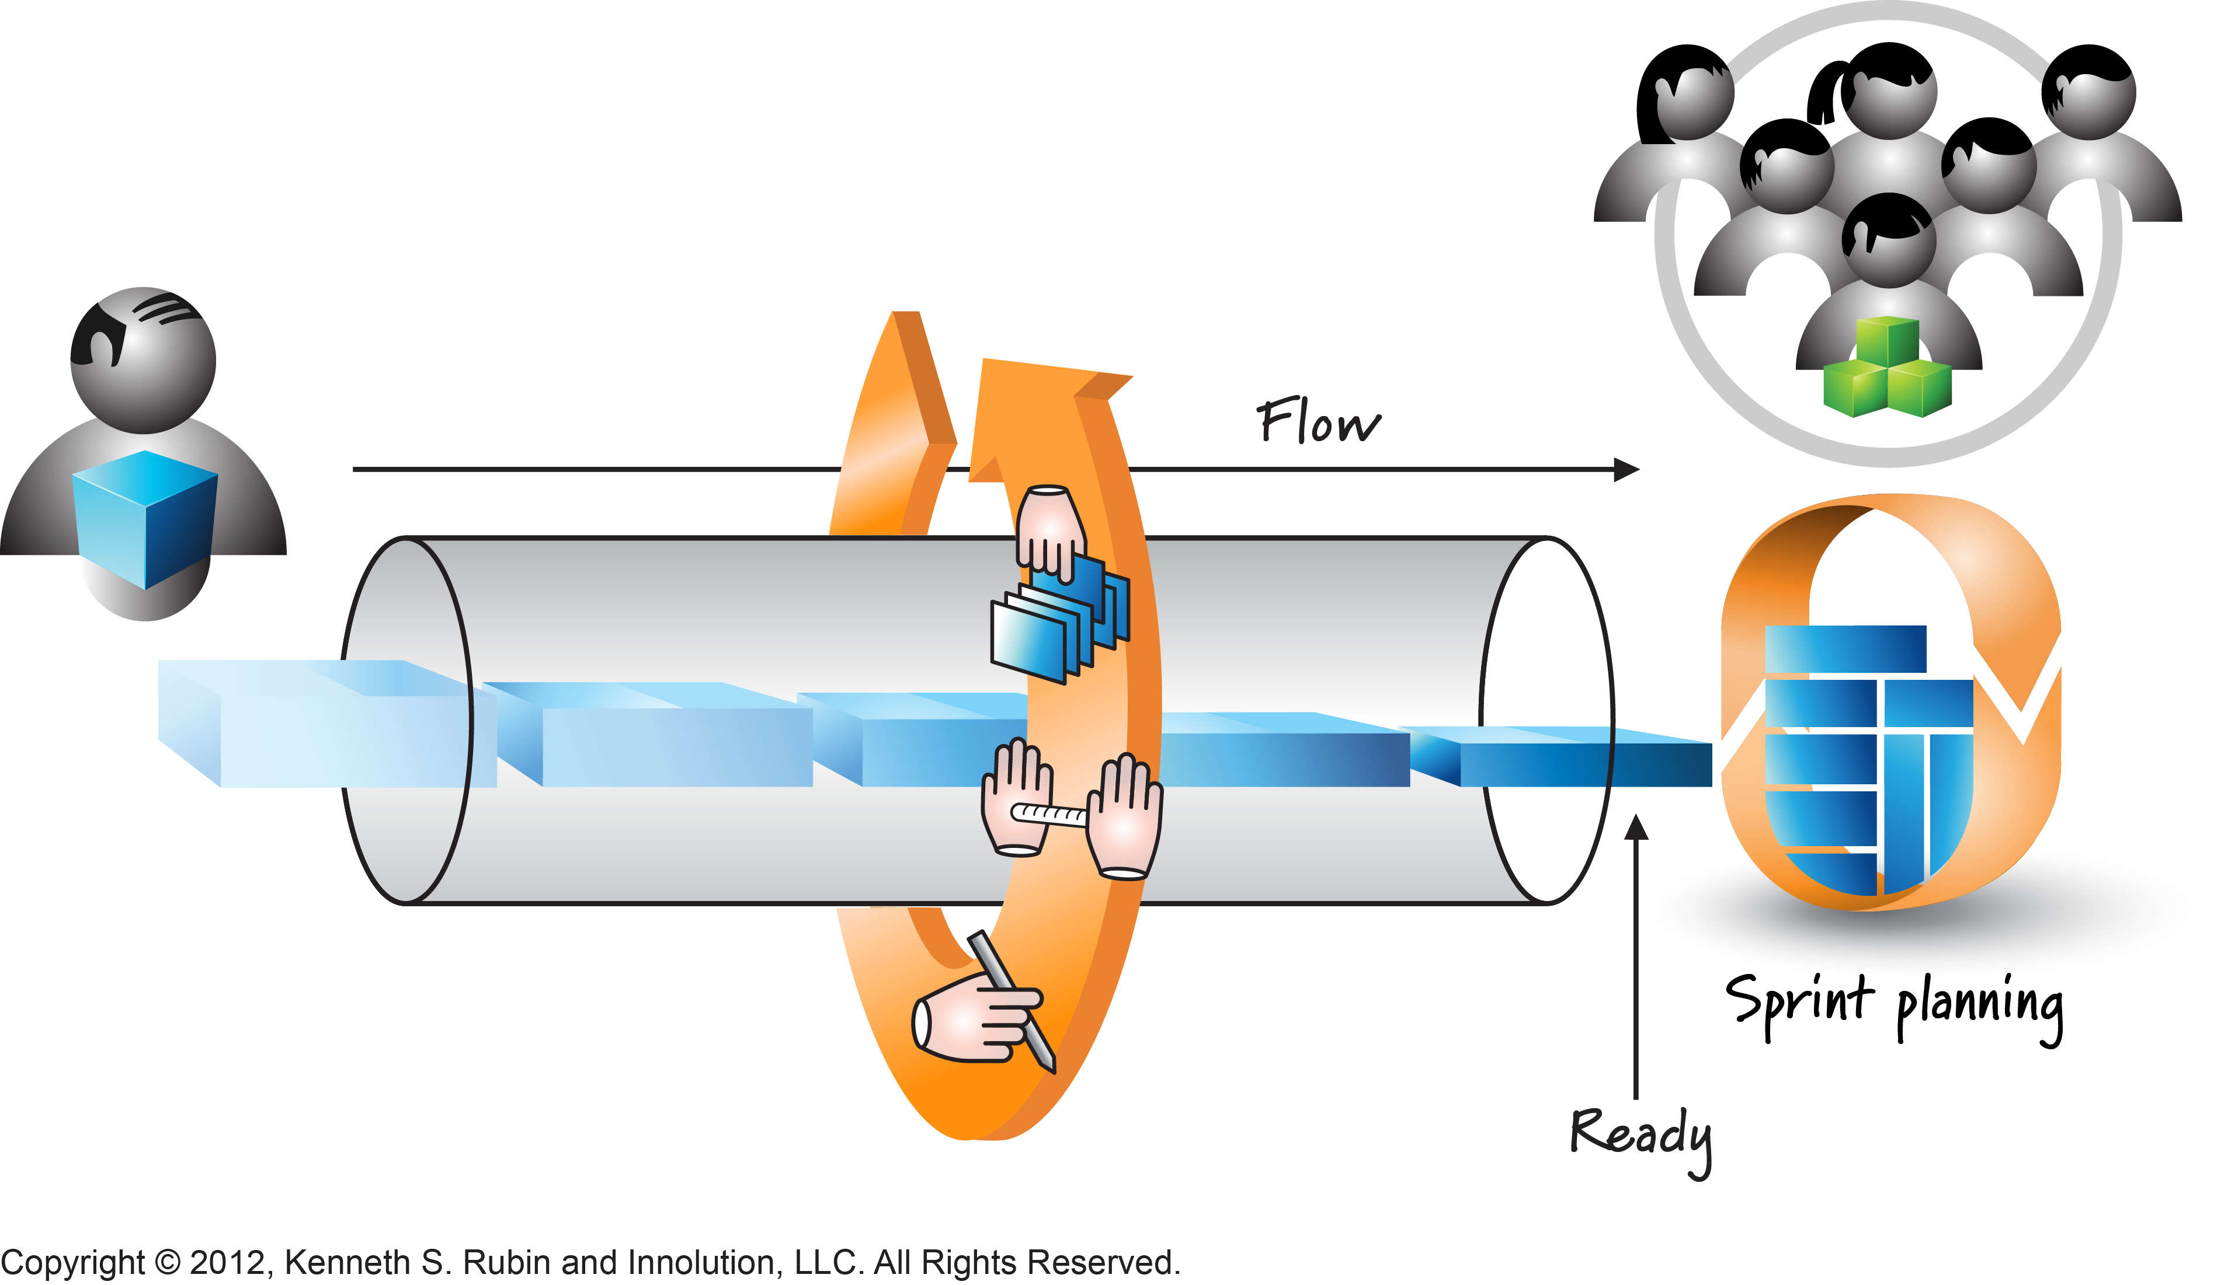
SCRUM (Artifacts)

Slide 44
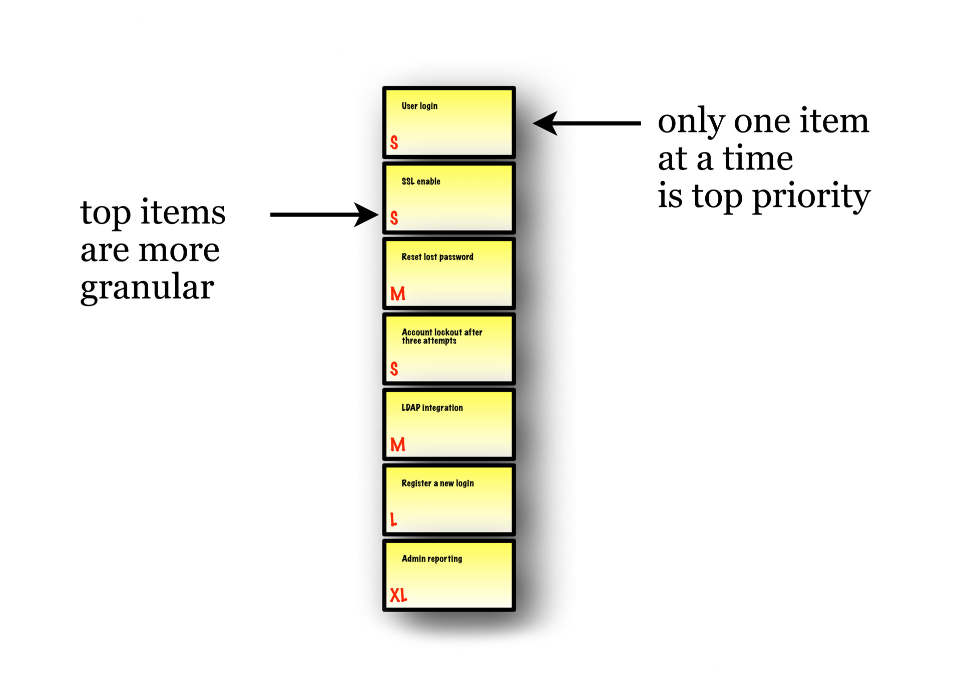

Slide 45
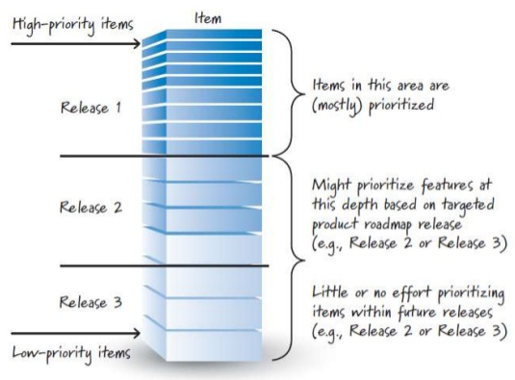

Slide 46
SCRUM (Artifacts)
Product Backlog
Usually is created during the First Sprint Planning Meeting
Can be changed and re-prioritized before each SPM
Is only a FORECAST!-> is not exact

Slide 47
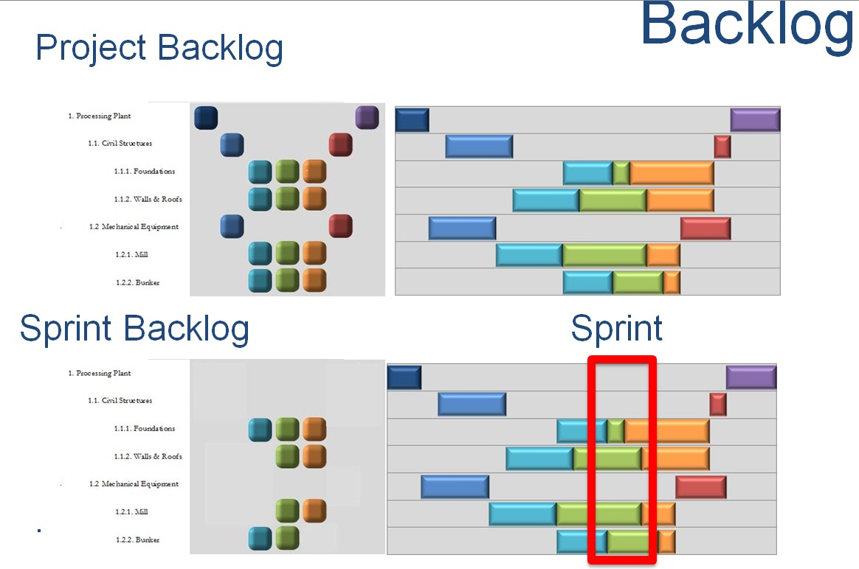

Slide 48
SCRUM (Artifacts)
Sprint Backlog
A subset of Product Backlog Items, which define the work for a Sprint
Is created ONLY by Team members
Each Item has it’s own status
Should be updated every day

Slide 49
SCRUM (Artifacts)
Sprint Backlog
No more then 100 tasks in the list
If a task requires more than 10 hours, it should be broken down
Team can add or subtract items from the list. Product Owner is not allowed to do it

Slide 50
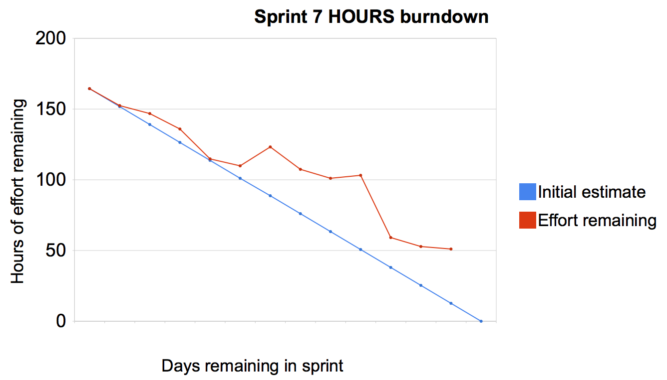

Slide 51
SCRUM (Artifacts)
Burn Down Chart
Are used to represent “work done”
Are wonderful Information Radiators
X-Axis: time (usually in days)
Y-Axis: remaining effort

Slide 52
SCRUM (Artifacts)
Burn Down Chart
3 Types:
Sprint Burn down Chart (progress of the Sprint)
Release Burn down Chart (progress of release)
Product Burn down chart (progress of the Product)

Slide 53
User Stories
A Story explains how a feature is to be used and gives it context. The proper way to write Stories is to start by: As a [ user / role ], I want [ do some action / goal / need / desire ] (optionally: so that [ desired result / benefit ])

Slide 54
User Stories (Examples)
i.e. As a user, I want to search for my customers by their first and last names. i.e. As a non-administrative user, I want to modify my own schedules but not the schedules of other users.

Slide 55
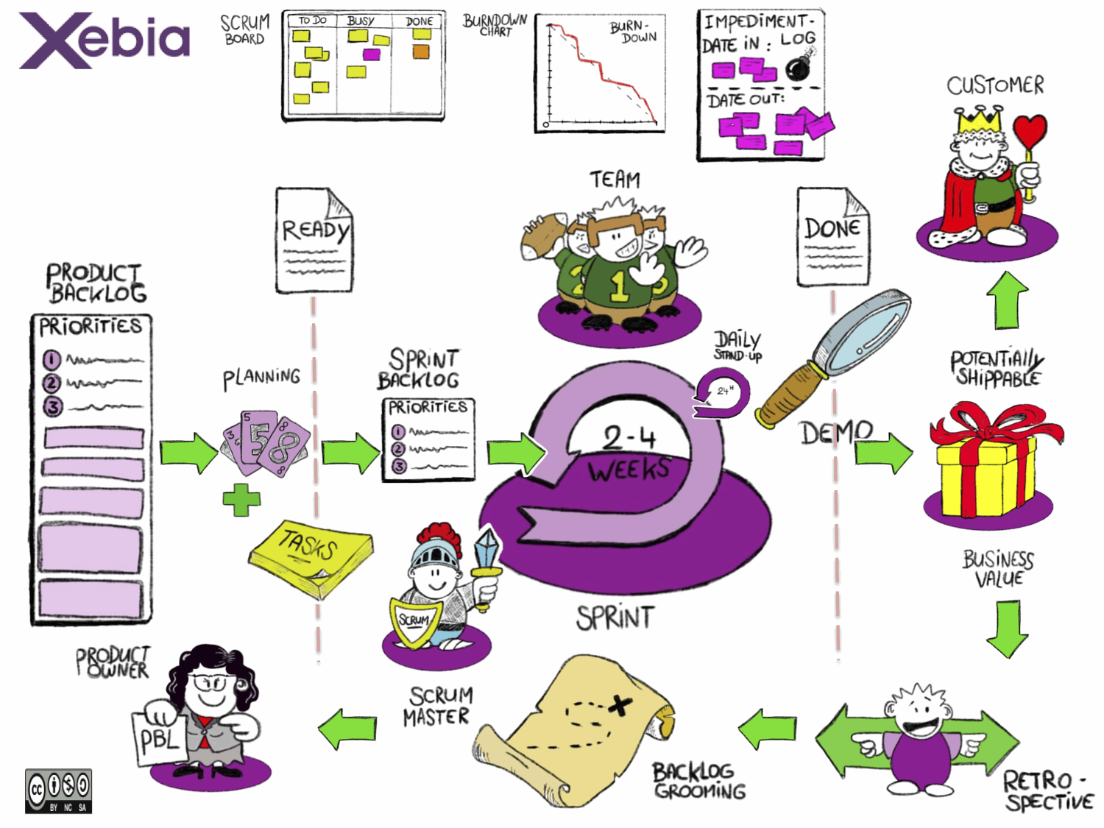

Slide 56
EXPECTATIONS
https://cspietmllab.herokuapp.com/aboutusnew
http://www.cspiet.poornima.org
http://www.cspiet.poornima.org/KYS_CORE/editHome
http://www.cstech.poornima.org
Demo( deep Learning
Git Hub profile(https://github.com/deepakmoud)
Project deployment
Planning, Teamwork, Communication, Learning

Slide 57



Slide 58



Slide 59
Thank-You
Jai-Jai Poornima Sansthan
Jai Hind

